Slide 1
Indoor Air Quality Monitoring of Mobile Computing Lab
Abstract: Quality air is the right of every human living on earth. If the quality of air is bad, it could lead to severe health consequences. In this project, we attempt to provide an air monitoring system for MCL to save the students from bad air and improve their stay in the lab in terms of health and productivity. We consider CO2 gas, Particulate Matter (PM2.5 and PM10), temperature, humidity and pressure as measuring factors. The data is taken from the sensors and visualized. Different events such as fire and smoke are enforced the pattern in the data is recorded. Since the data is not historical, so we used unsupervised learning to find the clusters in the data. Results show that the data has mainly 3 clusters indicating normal behavior, fire and smoke.
Author: Shabir Ahmad
Kernel URL: https://www.kaggle.com/shabirahmad/airquality
Dataset URL: https://www.kaggle.com/shabirahmad/mclindoorairquality

Slide 2
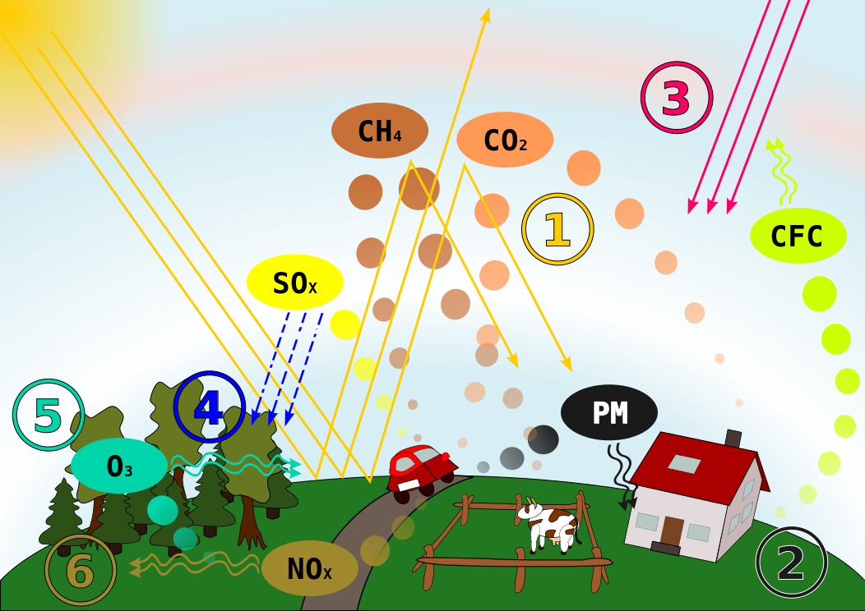
Air Pollution - Learn the basics
Air pollution means exactly what you think it means : it's when the quality of the air you breathe drops. But how does that happen ? That's the real question. It's induced by the presence of harmful, unwanted substances in air (more precisely, into Earth's atmosphere). Those bad substances are the pollutants and most of the tables in this database focus on those pollutants and give information about their presence in the air.
The following gases play vital role in the qualifying air
Sulphur dioxide ( SO2 ) : This contaminant is mainly emitted during the combustion of fossil fuels such as crude oil and coal.
Carbon dioxide ( CO22) : This gas consists during incomplete combustion of fuels example : A car engine running in a closed room.
Nitrogen dioxide ( NO2 ) : These contaminants are emitted by traffic, combustion installations and the industries.
Ozone ( O3 ) : Ozone is created through the influence of ultra violet sunlight (UV) on pollutants in the outside air.
Particulate Matter ( PM ) : Particulate matter is the sum of all solid and liquid particles suspended in air. This complex mixture includes both organic and inorganic particles, such as dust, pollen, soot, smoke, and liquid droplets. These particles vary greatly in size, composition, and origin.

Slide 3
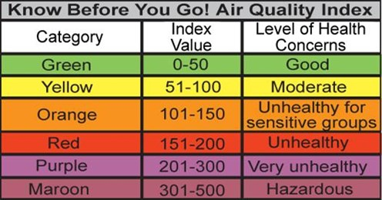
Air Quality Index
In several tables in this database, you'll find a column 'aqi' which stands for Air Quality Index. Basically the AQI is the measure of how air is polluted, with respect to some pollutant. That means that for a specific hour in a specific place you'll have different AQIs, one for each pollutant.
So one must know what values of AQI mean 'good' and what values mean 'bad', hence the table below.

Slide 4
Worklist
Methodology
Experimental Setup
Creating web server to listen requests and provide the response
Getting data from Sensors
Applying some events and finding consequences based on the event
Uploading dataset to Kaggle
Reading dataset
Preprocessing and Normalization
Visualization
Columns Analysis
Pair plot for different distributions
Seaborn Heatmap for correlation
Finding distribution and skewness
Unsupervised Learning
Kmean Clustering
Clustering Visualization

Slide 5
Methodology
We use two IoT devices to which different sensors are connected
We use Raspberry PI Model B and Arduino WEMOS D1 as IoT gateways
IoT Servers are installed on respective devices to communicate with the staging server
Nova Dust Sensor and BME 280 Sensor are connected to Raspberry PI whereas MQ-2 gas sensor is connected with Arduino
The server installed on these devices exposed API endpoints from where the staging server consumes the data generated from these sensors
The data are ingested to the Kaggle and analyzed

Slide 6
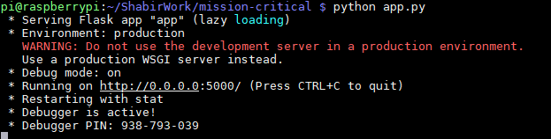
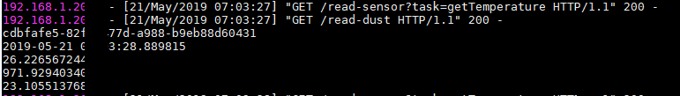
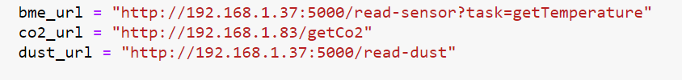
Web Server Hosted on IoT Devices
For this, we use Flask, a lightweight python framework and deploy it on Raspberry PI.
Figure 1 shows the instance of the application in which the web server is running and listening to incoming HTTP requests
Figure 2 shows the the CLI showing the mechanism on how to serve temperature sensor requests
The server is exposing API endpoints which can be accessed by different authorized server to get the data
Figure 3 shows the URI, which if triggered will give the corresponding JSON response

Slide 7
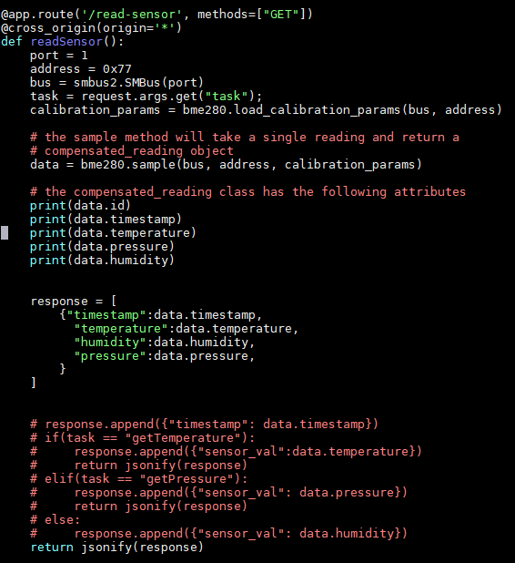
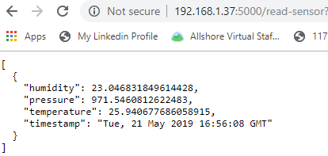
Sample Code for BME Sensor
Return Temperature, Humidity and Pressure
http://192.168.1.37:5000/read-sensor

Slide 8
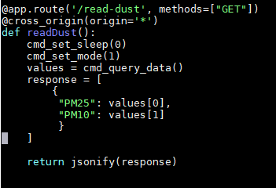
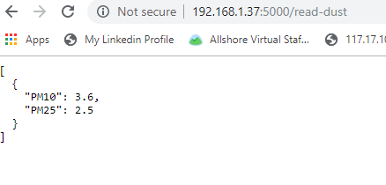
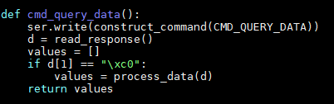
Reading Dust Sensor Endpoint: http://192.168.1.37:5000/read-dust

Slide 9
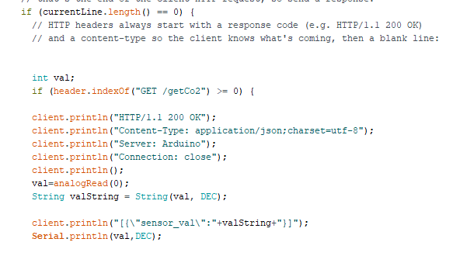
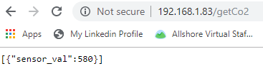
Reading CO2 Gas Values Endpoint: http://192.168.1.83/getCo2

Slide 10
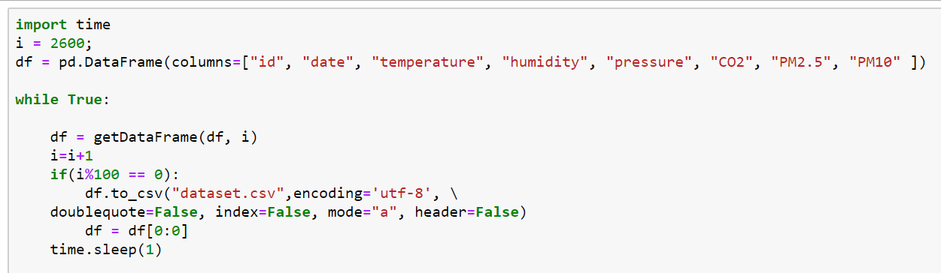
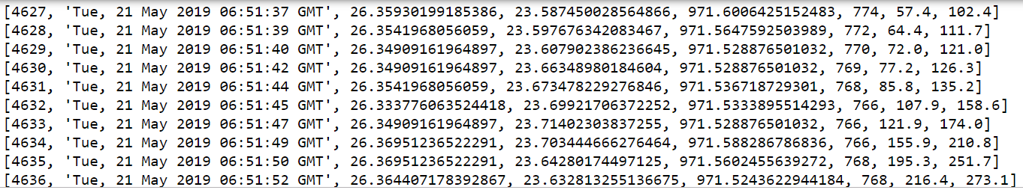
Data Staging and Dataset Creation on PC Server for process tasks

Slide 11
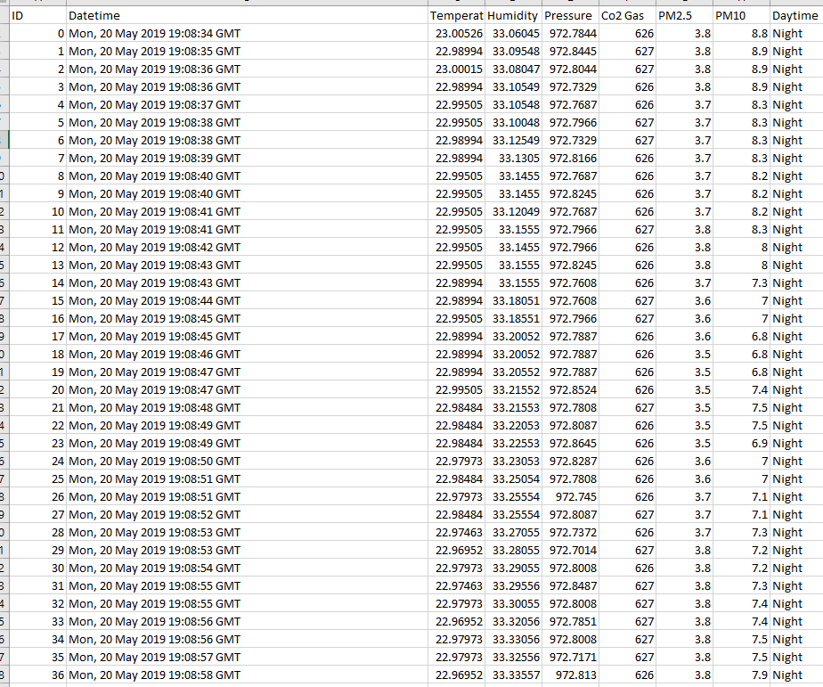
Generated Dataset
The dataset generated has 9 columns
ID is unique id for every sensor reading
Datetime is the instant at which the sensor reading is taken
Temperature, humidity, Pressure is the BME sensor reading
Co2 gas is the saturation of CO2 in air and generated by MQ-2 sensor
PM 2.5 and PM 10 are particulate matter which are taken from Nova Dust sensor
Daytime is either Night or day depends upon the time the data taken

Slide 12
Experimental Environment and Hardware
MQ-2 Gas Sensor
Dust Sensor
BME Sensor
Lighter for invoking Smoke and Fire
PC Server
Raspberry PI Model B
Arduino WEMOS D1
Breadboard
Connecting Wires

Slide 13

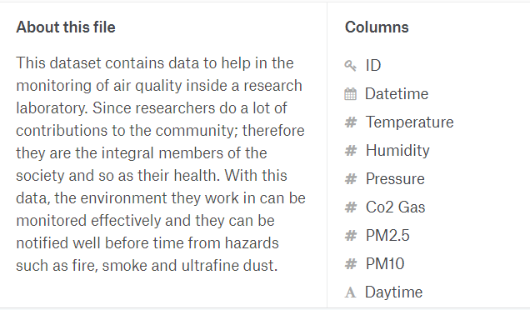
Dataset Analysis on Kaggle
First, dataset is uploaded to Kaggle and has been described.
Second, a kernel is created to consume the data and do some data science on it.
It should be NOTED that the data is purely current data and doesn’t reflect any historical pattern. Also, it doesn’t have any labels associated with it, there supervised learning is not possible.
We perform some preprocessing on it and afterwards, apply clustering techniques on it to identify the clusters.
Figure shows the dataset on Kaggle

Slide 14
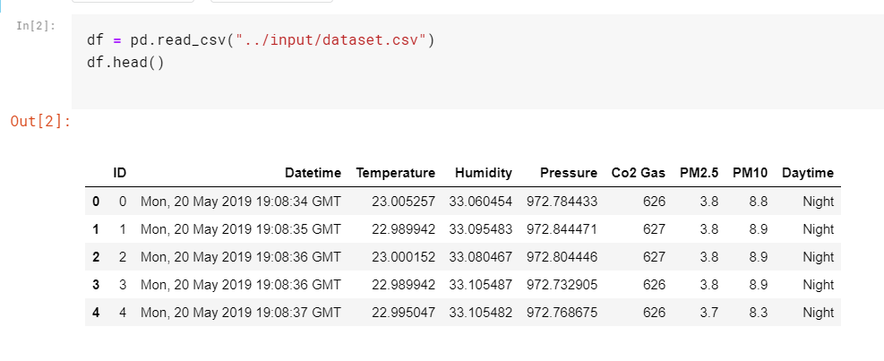
Reading Dataset in Pandas Dataframe

Slide 15
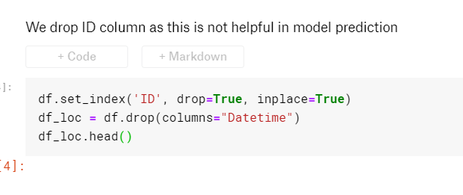
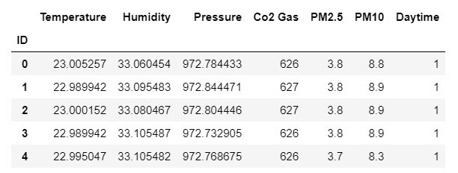
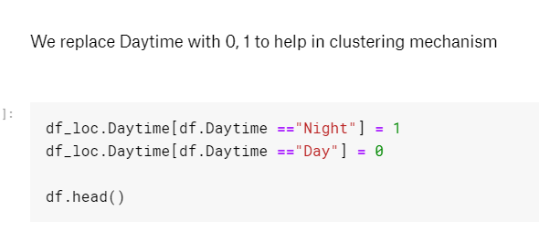
Preprocessing

Slide 16
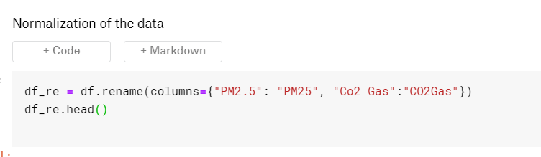
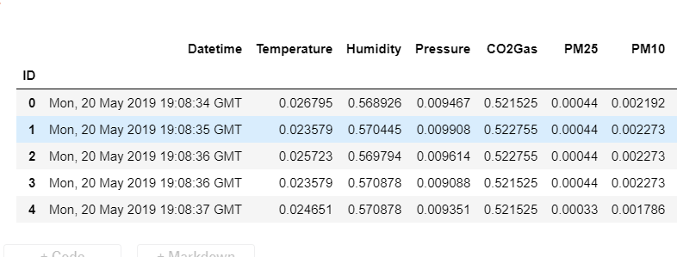
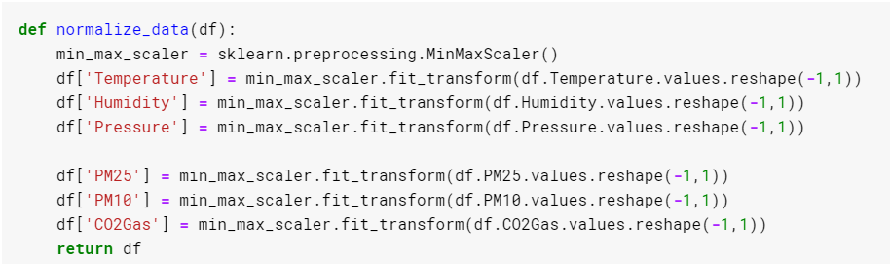
Normalization

Slide 17
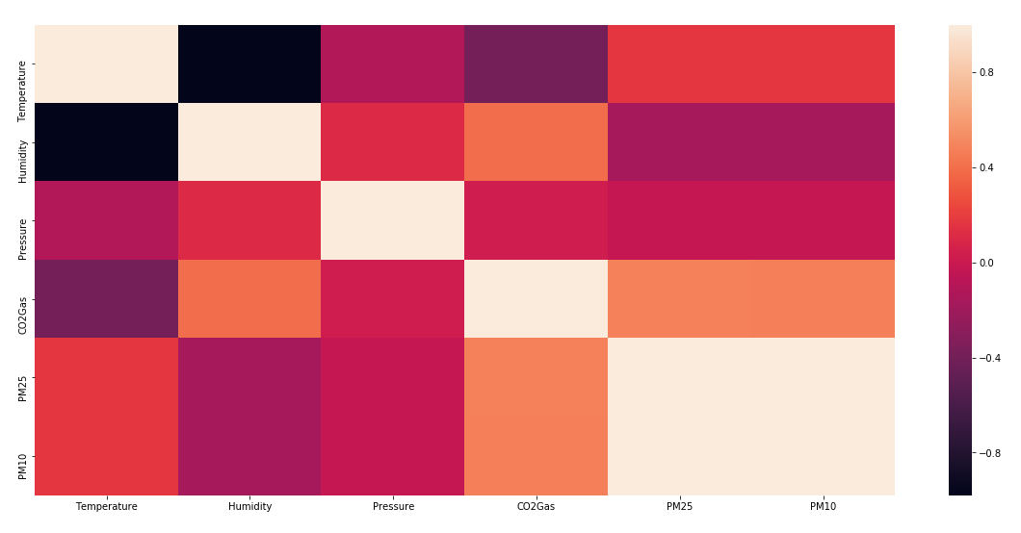
Correlation Using Seaborn Heatmap
It can be correlated from the map that temperature has positive correlation with PM 2.5 and PM 10 and same but inverse relationship with humidity
The correlation of Pressure is not visible
Similarly the correlation of Co2 gas is also positive
The correlation of PM 2.5 and PM 10 is 0, there is no dependencies as a consequence.
This map shows the impact of different parameters on air quality

Slide 18
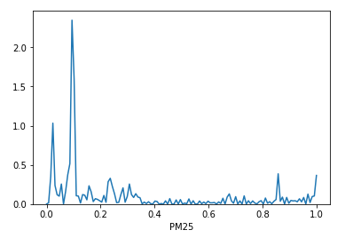
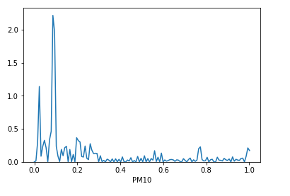
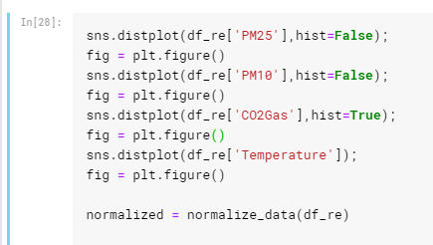
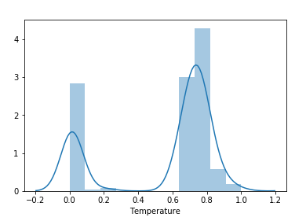
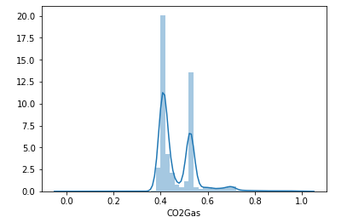
Distribution of Different Parameters in Computing Air Quality

Slide 19
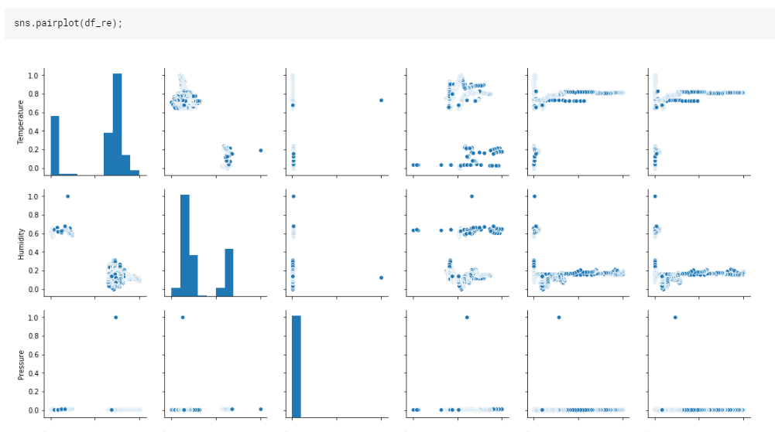
Pair Plot

Slide 20
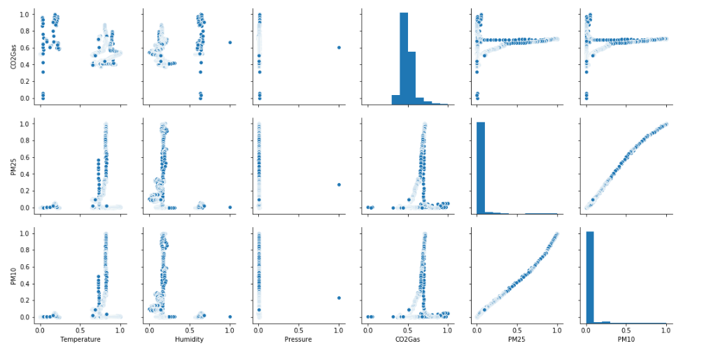
Pairplot (Con’t)

Slide 21
Machine Learning
As the data is not labelled and is more current data, so the following unsupervised learning methods can be considered
KMean Clustering
Hidden Markov Chain
Deep Belief Network
In this work, we tried with KMean Clustering and analyzed the results.
The results are not that fancy, but for a current data it is a good point to start and tweak the parameters to improve it.

Slide 22
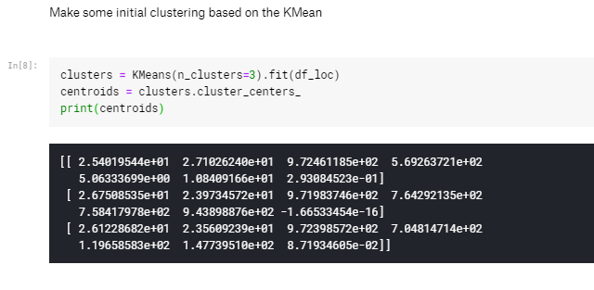
K-Mean Clustering
K-Means is the ‘go-to’ clustering algorithm for many simply because it is fast, easy to understand, and available everywhere (there’s an implementation in almost any statistical or machine learning tool you care to use).
K-Means has a few problems however. The first is that it isn’t a clustering algorithm, it is a partitioning algorithm. That is to say K-means doesn’t ‘find clusters’ it partitions your dataset into as many (assumed to be globular) chunks as you ask for by attempting to minimize intra-partition distances.
That leads to the second problem: you need to specify exactly how many clusters you expect. If you know a lot about your data then that is something you might expect to know. If, on the other hand, you are simply exploring a new dataset then ‘number of clusters’ is a hard parameter to have any good intuition for.

Slide 23
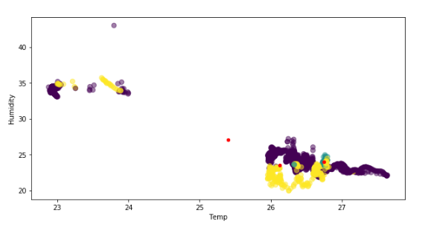
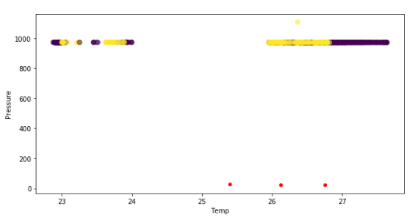
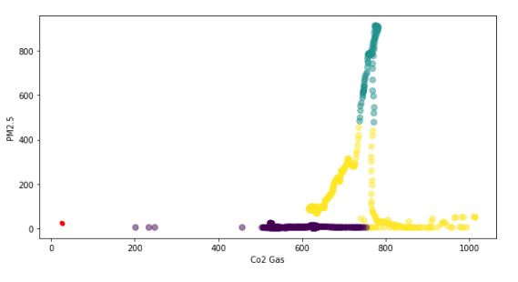
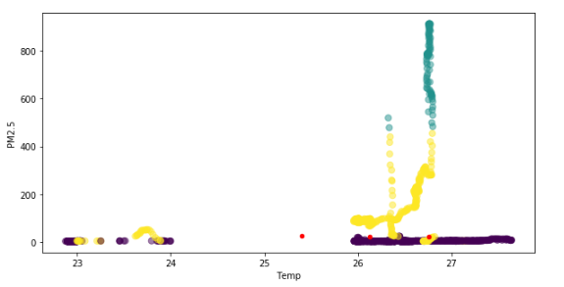
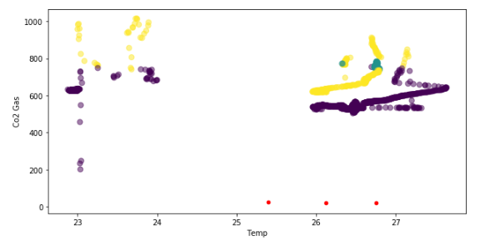
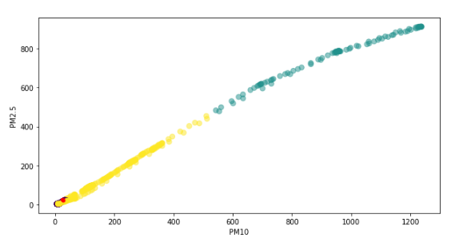
Results Scatterplot of different parameters are drawn
Discussion
The scatterplot shown in figure 1,2 are not separable which means the correlation between humidity and temperature is weak in affecting air quality
The scatterplot shown in 3, 4 and 6 are separable which means there is a strong correlation between the x and y parameters in contributing the air quality
The scatterplot shown in 5 shows mild correlation between Co2 and Temp in computing Air Quality

Slide 24
Future Directions
In this work, the data is taken from indoor environment and is spanned across a single day
The data can be expanded to take some samples every data for a long time
Some more events should be instantiated to change the pattern in the data
Other parameters such as outdoor AQI from Naver Open API should be considered and the deviation should be investigated

Slide 25
Conclusion
In this work we have performed two distinct set of activities
Contextual Data Collection From Sensors
We have taken data from BME 280, Nova Dust Sensor, Co2 Gas sensor and made a web server to periodically trigger the endpoints and take the latest data from these sensors
The data is exported to CSV format and uploaded to Kaggle
Data Analysis on Data in Kaggle
The next thing we did is the import of the data and analyzed its various parameters, the distribution of the features and its impact towards air quality. Similarly, we also did a simple unsupervised clustering mechanism to find different clusters in the data and with value 3, the clusters are separable.

Slide 26
Questions?

